Slide 1
Modeling the Effects of Flow Conditions and Rheology on Lava Flows with Polyethylene Glycol
Asu/nasa Space Grant Symposium
Cara Courtney
Director: Dr. Amanda B. Clarke
Arizona State University School of Earth & Space exploration

Slide 2

About me
Cara Courtney
Graduating Senior at Arizona State University
Mechanical Engineering Major
Sustainability Minor
Working at Dell Technologies in August
Servers
Original Equipment Manufacturing
ASU Women’s Club Soccer, Devils’ Advocates: ASU volunteer tour guides

Slide 3
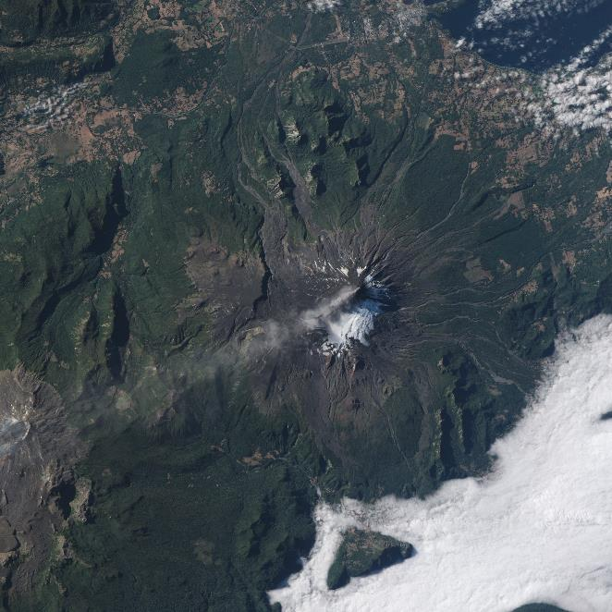
Project Motivation
Historically, predictive models for lava flows are statistics-based using data of past flows.
Physics-based models can be crucial in understanding how a flow will behave and how it can impact humans.
Notes:
Add bullet or slide 3-4 pictures of complex processes that only physics could captures (breakouts/tounges/levees/inflation)
Introduce why lava flows so complex

Slide 4
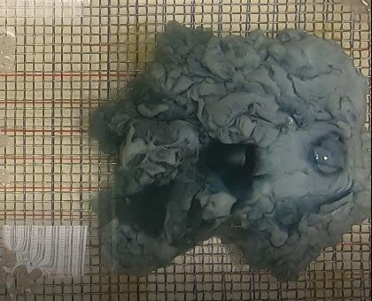
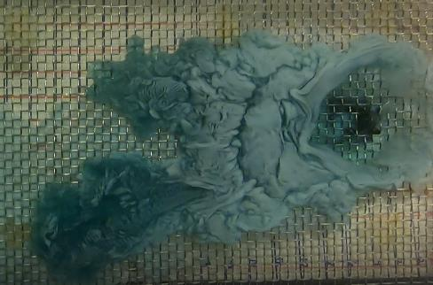
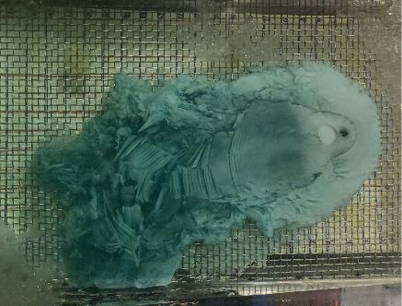
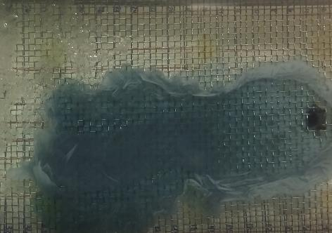
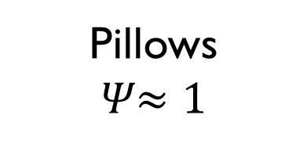

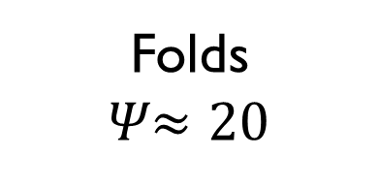
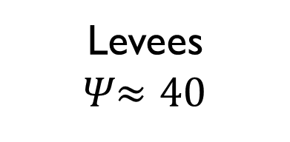
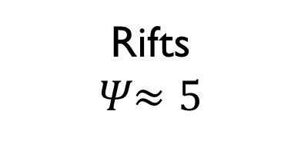
Technical Background
𝛹 is a ratio of timescales, the characteristic timescale of thermal flux from the vent and the characteristic timescale of crust formation due to surface cooling
Increasing $Ψ$
Pillows
𝛹$≈1$
Rifts
𝛹$≈5$
Folds
𝛹$≈20$
Levees
𝛹$≈40$
Notes:
Slide explaining psi equations

Slide 5
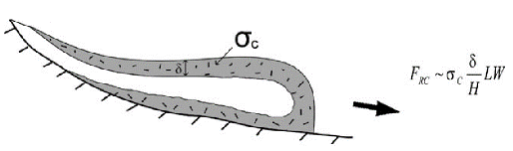
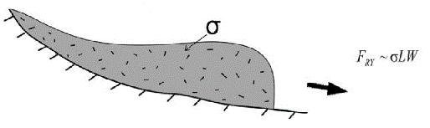
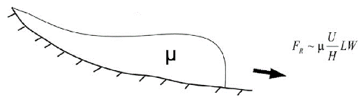

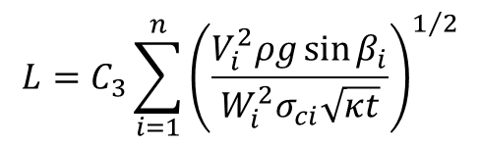
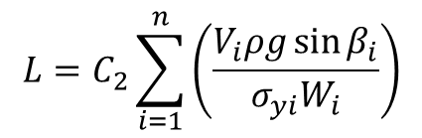
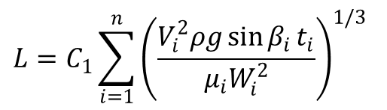
Technical Background
Yield Strength of the Crust (YSC)
Yield Strength of the Core (YS)
Newtonian Viscosity
$$L=C_{3}\sum_{i=1}^{n}{{\left(\frac{V_{i}^{2}ρg\sin{β_{i}}}{W_{i}^{2}σ_{ci}\sqrt{κt}}\right)}^{1/2}}$$
$$L=C_{2}\sum_{i=1}^{n}{\left(\frac{V_{i}ρg\sin{β_{i}}}{σ_{yi}W_{i}}\right)}$$
$$L=C_{1}\sum_{i=1}^{n}{{\left(\frac{V_{i}^{2}ρg\sin{β_{i}}t_{i}}{μ_{i}W_{i}^{2}}\right)}^{1/3}}$$
Increasing $Ψ$
We hypothesize that flows with high psi values will correlate best with Newtonian models, and those with low psi values will correlate best with YSC models.
Notes:
Break up the models more slowly, describe what the models are actually doing (Cons of mass & momentum) numerator=flux, denominator=slowing
Reference on the slide

Slide 6
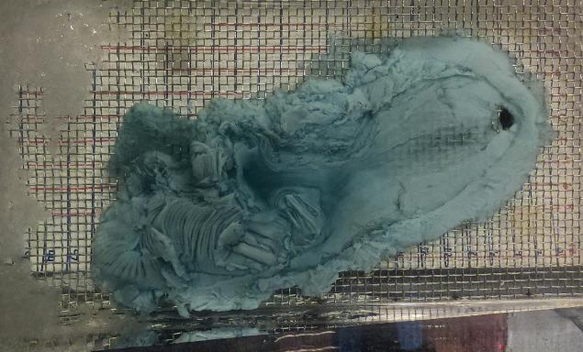
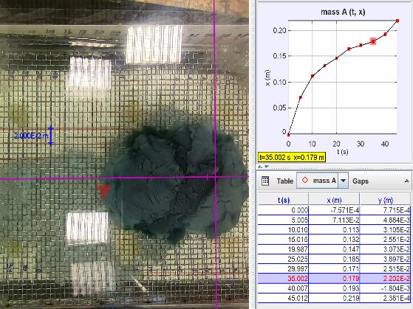
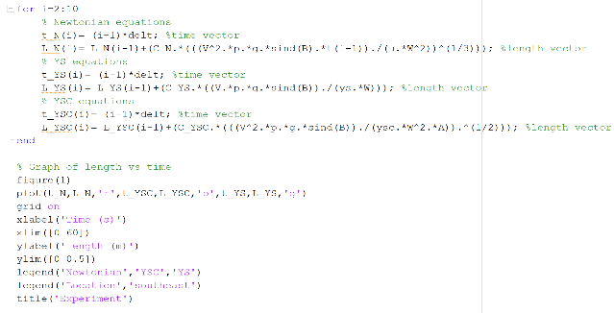




Method
Run experiments with a known $Ψ$ value and morphology
Use Tracker Video Analysis to determine flow behavior
Compare flow data to physics-based models in MATLAB

Slide 7
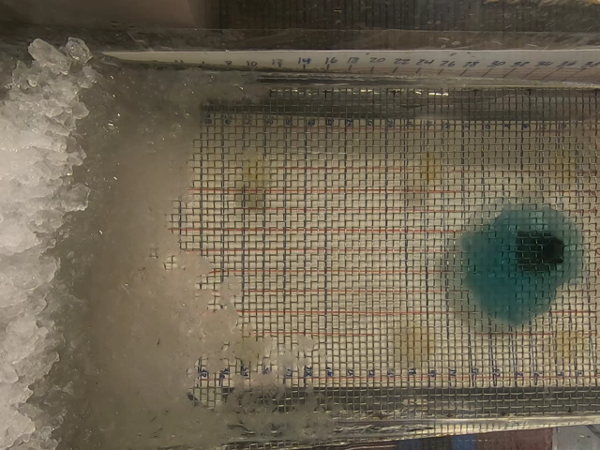
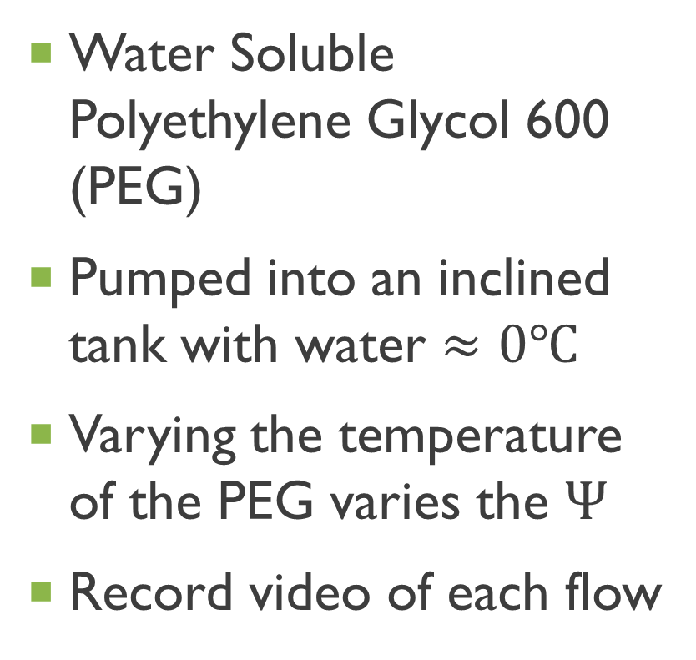
Experimental Setup
Water Soluble Polyethylene Glycol 600 (PEG)
Pumped into an inclined tank with water $≈0℃$
Varying the temperature of the PEG varies the $Ψ$
Record video of each flow
Notes:
Look for lab photo, 2-3 more slides, with more videos “typical” flow, notice how crust and stuff

Slide 8
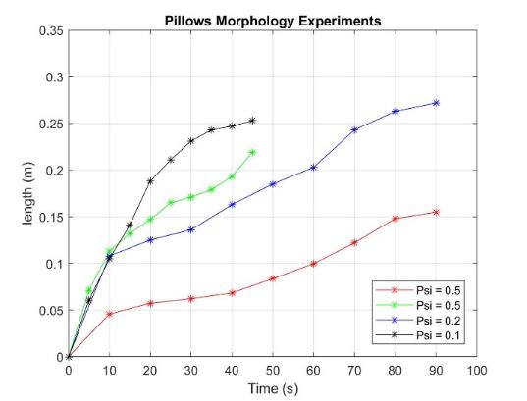
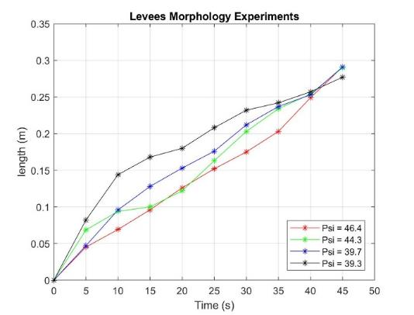
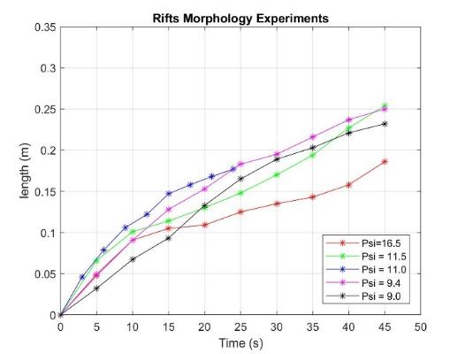
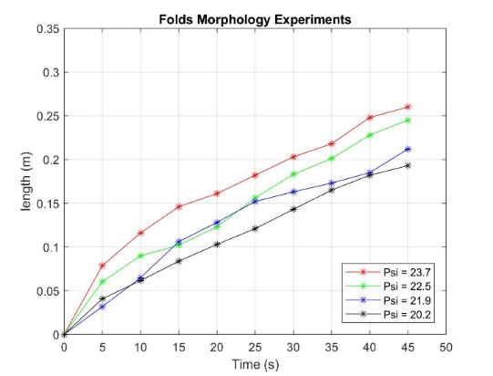
Discussion of experimental data trends
1
Pillowed Flows: higher rate of length propagation, slower rate (growing in thickness), then higher rate again
Rifted Flows: concave shape, higher rate of length population, then a slower rate
Folded Flows: more linear behavior than previous flows
Leveed Flows: linear behavior like folded flows, but at a faster rate of length propagation
3
2
4
Notes:
Maybe start with trends, then show the video that explains the trend after
Describe trends looking at the plots & video

Slide 9
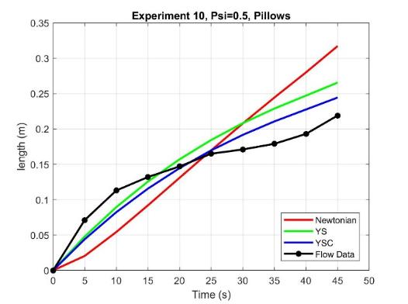
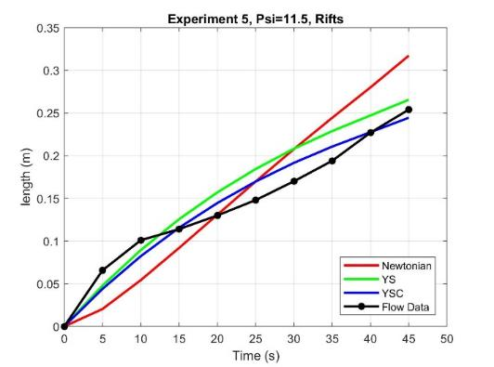
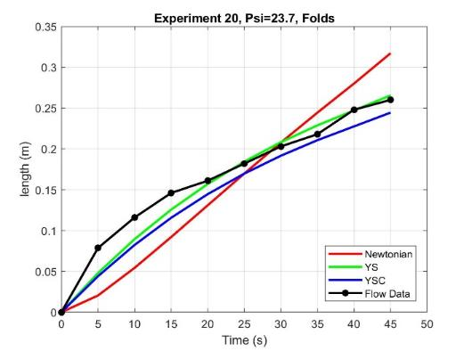
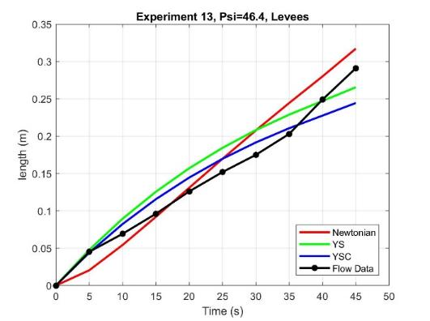
Discussion of The Models
Pillows
Rifts
Folds
Levees
YSC best fit
YSC best fit
YS best fit
YSC or Newtonian
Experiment | 𝛹 Value | Morphology | Newtonian | YS | YSC
10 | 0.5 | Pillows | 4.576 cm | 2.704 cm | 1.936 cm
5 | 11.5 | Rifts | 3.410 cm | 2.091 cm | 1.267 cm
20 | 23.7 | Folds | 3.367 cm | 1.064 cm | 1.821 cm
13 | 46.4 | Levees | 1.978 cm | 2.021 cm | 1.624 cm
Notes:
Slides before this one, show each model by itself and describe why Newtonian is linear, etc. don’t rush this slide

Slide 10
Conclusions
Comparisons between experiments and models support our original hypothesis that low 𝛹 value flows are better captured by the YSC model.
Although, the Newtonian model did not perfectly capture the behavior of any experimental flows in this study, high 𝛹-value flows that formed levees exhibited the most Newtonian behavior

Slide 11
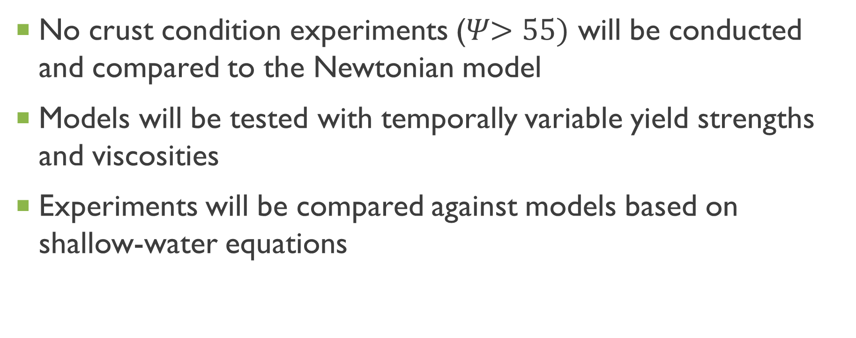
future work
No crust condition experiments (𝛹$>55)$ will be conducted and compared to the Newtonian model
Models will be tested with temporally variable yield strengths and viscosities
Experiments will be compared against models based on shallow-water equations

Slide 12
Acknowledgements and references
Acknowledgements
References
Dr. Amanda Clarke
Sean Peters
Dr. Huei-Ping Huang
Dr. David A. Williams
Castruccio, Angelo, et al. Evolution of Crust- and Core-Dominated Lava Flows Using Scaling Analysis. Springer-Verlag Berlin Heidelberg , 2013.
Fink, Johnathan H., and Ross W. Griffiths. Radical Spreading of Viscous-Gravity Currents with Solidifying Crust. J. Fluid Mechanics1990.
Gregg, Tracy K.P., and Jonathan H. Fink. A Laboratory Investigation into the Effects of Slope on Lava Flow Morphology. Journal of Volcanology and Geothermal Research, 2000

